Slide 1
UNIT-II
Agile Development: What is Agility, Agility and the cost of change, What is an Agile Process, Agile Process Extreme programming, SCRUM, Dynamic Systems Development Method, Agile Unified Process.
Requirements Engineering: Establishing the ground work, Eliciting requirements, Developing use cases, Building the Analysis model, Negotiating Requirements, Requirement Monitoring, Validating Requirements.
Design concepts: The Design Process, Design Concepts, The Design Model.

Slide 2
Agile Software Development
In the modern economy, it is often difficult or impossible to predict how a software system will evolve as time passes.
Market conditions change rapidly, end-user needs evolve, and new
competitive threats emerge without warning.
In many situations, you won’t be able to define requirements fully before the project begins.

Slide 3
You must be agile enough to respond to a changing business environment And change is expensive.Particularly if it is uncontrolled or poorly managed.
One of the most compelling characteristics of the agile approach is its ability to reduce the costs of change throughout the software process.

Slide 4
What is Agility?
Effective response to change.
Effective communication among all stakeholders
Drawing the customer onto the team;eliminate the “us and them” attitude.
Organizing a team so that it is in control of the work performed.
Rapid, incremental delivery of software holders

Slide 5
What is “Agility”?
In Jacobson’s view, the pervasiveness of change is the primary driver for agility.
Software engineers must be quick on their feet if they are to accommodate the rapid changes that Jacobson describes.
An agile process reduces the cost of change because software is released in increments and change can be better controlled within an increment
“Agility is dynamic, content specific, aggressively change embracing, and growth oriented.”

Slide 6
Agility and the Cost of Change
A well-designed agile process “flattens” the cost of change curve
Allowing a software team to accommodate changes late in a software project without dramatic cost and time impact.
You’ve already learned that the agile process encompasses incremental delivery.
When incremental delivery is coupled with other agile practices such as continuous unit testing and pair programming the cost of making a change is attenuated.

Slide 7
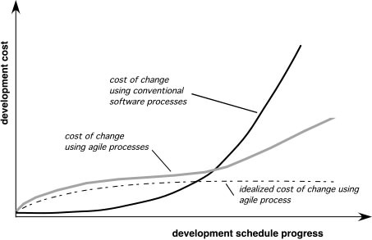
Agility and the Cost of Change

Slide 8
An Agile Process
It is difficult to predict in advance which software requirements will persist and which will change. It is equally difficult to predict how customer priorities will change as the project proceeds.
For many types of software, design and construction are interleaved. That is, both activities should be performed in tandem so that design models are proven as they are created. It is difficult to predict how much design is necessary before construction is used to prove the design.
Analysis, design, construction, and testing are not as predictable (from a planning point of view) as we might like

Slide 9
How do we create a process that can manage unpredictability?
An agile process, therefore, must be adaptable.
An agile software process must adapt incrementally
Software increments (executable prototypes or portions of an operational system) must be delivered in short time periods so that adaptation keeps pace with change (unpredictability).
This iterative approach enables the customer to evaluate the software increment regularly, provide necessary feedback to the software team, and influence the process adaptations that are made to accommodate the feedback

Slide 10
1.Agility Principles
Our highest priority is to satisfy the customer through early
and continuous delivery of valuable software.!
Welcome changing requirements, even late in development.
Deliver working software frequently, from a couple of weeks to a couple of months, with a preference to the shorter timescale.
Business people and developers must work together daily throughout the project.

Slide 11
5. Build projects around motivated individuals. Give them the environment and support they need, and trust them to get the job done.
The most efficient and effective method of conveying information to and within a development team is face–to–face conversation.
Working software is the primary measure of progress.
Agile processes promote sustainable development. The sponsors, developers, and users should be able to maintain a constant pace indefinitely.

Slide 12
9.Continuous attention to technical excellence and good design enhances agility.
10.Simplicity – the art of maximizing the amount of work not done – is essential.
11.The best architectures, requirements, and designs emerge from self–organizing teams.
12. At regular intervals, the team reflects on how to become more effective, then tunes and adjusts its behavior accordingly.

Slide 13
2.The Politics of Agile Development
Traditional methodologists are a bunch of stick-in-the-muds who’d rather produce flawless documentation than a working system that meets business needs.”
Even within the agile school itself, there are many proposed process models each with a subtly different approach to the agility problem.
Within each model there is a set of “ideas” (agilists are loath to call them “work tasks”) that represent a significant departure from traditional software engineering.

Slide 14
And yet, many agile concepts are simply adaptations of good software engineering concepts.
Bottom line: there is much that can be gained by considering the best of both schools and virtually nothing to be gained by denigrating either approach.

Slide 15
3.Human Factors
Competence - encompasses innate talent, specific software-related skills, and overall knowledge of the process that the team has chosen to apply. Skill and knowledge of process can and should be taught to all people who serve as agile team members.
Common focus. Although members of the agile team may perform different tasks and bring different skills to the project, all should be focused on one goal—to deliver a working software increment to the customer within the time promised.
Collaboration. Software engineering (regardless of process) is about assessing, analyzing, and using information that is communicated to the software team; To accomplish these tasks, team members must collaborate—with one another and all other stakeholders.

Slide 16
Decision-making ability. Any good software team (including agile teams) must be allowed the freedom to control its own destiny. This implies that the team is given autonomy—decision-making authority for both technical and project issues.
Fuzzy problem-solving ability. Software managers must recognize that the agile team will continually have to deal with ambiguity and will continually be buffeted by change. In some cases, the team must accept the fact that the problem they are solving today may not be the problem that needs to be solved tomorrow. However, lessons learned from any problem-solving

Slide 17
Mutual trust and respect. The agile team must become what DeMarco and Lister [DeM98] call a “jelled” team . A jelled team exhibits the trust and respect that are necessary to make them “so strongly knit that the whole is greater than the sum of the parts.”
Self-organization. In the context of agile development, self-organization implies three things:
(1) the agile team organizes itself for the work to be done,
(2) the team organizes the process to best accommodate its local environment,
(3) the team organizes the work schedule to best achieve delivery of the software increment

Slide 18
Extreme Programming (XP)
The most widely used approach to agile software development is Extreme Programming, the seminal work on the subject has been written by Kent Beck.
XP values
The XP Process
Industrial XP
The XP Debate

Slide 19
XP values
Beck defines a set of five values that establish a foundation for all work performed as part of XP, Each of these values is used as a driver for specific XP activities, actions, and tasks.
communication,
Simplicity-Refactoring allows a software engineer to improve the internal structure of a design (or source code) without changing its external functionality or behavior. In essence, refactoring can be used to improve the efficiency, readability, or performance of a design or the code that implements a design
feedback,
courage, and
respect.

Slide 20
The XP Process
XP uses an object-oriented approach as its preferred development paradigm,defines four (4) framework activities
Planning
Design
Coding
Testing

Slide 21
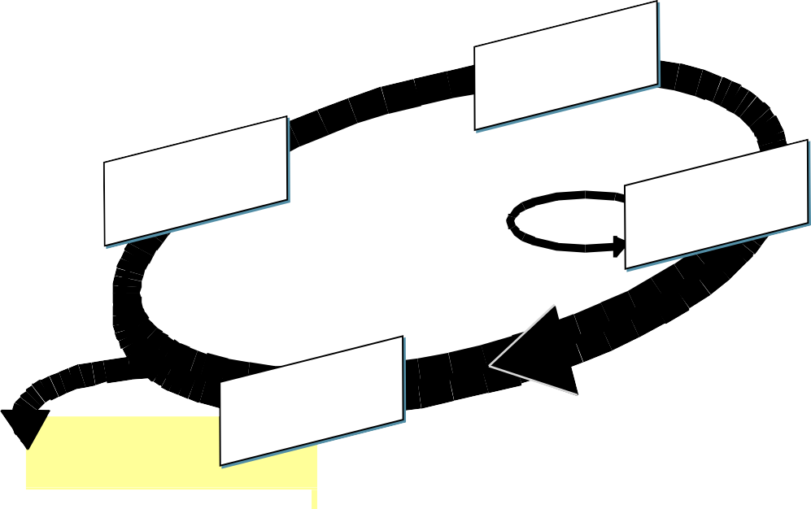
simple design
CRC cards
spike solutions
prototypes
user stories
values
acceptance test criteria
iteration plan
design
planning
coding
refactoring
test
pair programming
Release
software increment
project velocity computed
unit test
continuous integration
acceptance testing

Slide 22
Industrial XP
Joshua Kerievsky [Ker05] describes Industrial Extreme Programming (IXP) in the following manner: “IXP is an organic evolution of XP. It is imbued with XP’s minimalist, customer-centric, test-driven spirit.
IXP differs most from the original XP in its greater inclusion of management, its expanded role for customers, and its upgraded technical practices.”
IXP incorporates six new practices that are designed to help ensure that an XP project works successfully for significant projects within a large organization

Slide 23
Readiness assessment
Project community.
Project chartering
Test-driven management
Retrospectives
Continuous learning

Slide 24
The XP Debate
Stephens and Rosenberg argue that many XP practices are worthwhile, but others have been overhyped, and a few are problematic.
The authors suggest that the co dependent nature of XP practices are both its strength and its weakness.
Because many organizations adopt only a subset of XP practices, they weaken the efficacy of the entire process. Among the issues that continue to trouble some critics of XP are
Requirements volatility.
Conflicting customer needs.
Requirements are expressed informally
Lack of formal design

Slide 25
Scrum
Scrum is an agile software development method that was conceived by Jeff Sutherland and his development team in the early 1990s.
In recent years, further development on the Scrum methods has been performed by Schwaber and Beedle .
Scrum principles are consistent with the agile manifesto and are used to guide development activities within a process that incorporates the following framework activities: requirements, analysis, design, evolution, and delivery.

Slide 26
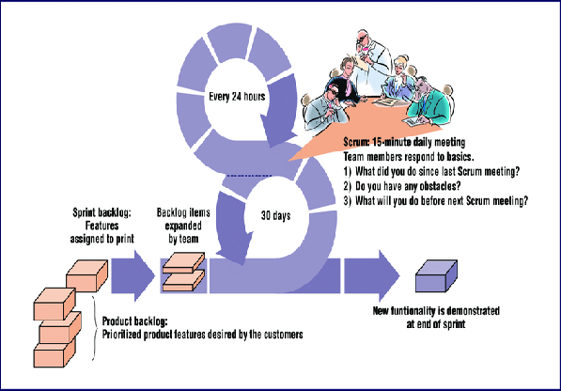

Slide 27
Scrum incorporates a set of process patterns that emphasize project priorities, compartmentalized work units, communication, and frequent customer feedback.
Backlog—a prioritized list of project requirements or features that provide business value for the customer.
Sprints—consist of work units that are required to achieve a requirement defined in the backlog that must be fit into a predefined time-box.
Demos—deliver the software increment to the customer so that functionality that has been implemented can be demonstrated and evaluated by the customer.

Slide 28
Scrum meetings
Scrum meetings—are short (typically 15 minutes) meetings held daily by the Scrum team. Three key questions are asked and answered by all team members :
• What did you do since the last team meeting?
• What obstacles are you encountering?
• What do you plan to accomplish by the next team meeting?
A team leader, called a Scrum master, leads the meeting and assesses the responses from each person. The Scrum meeting helps the team to uncover potential problems as early as possible. Also, these daily meetings lead to “knowledge socialization” and thereby promote a self-organizing team structure

Slide 29
The Dynamic Systems Development Method
The Dynamic Systems Development Method (DSDM) [Sta97] is an agile software development approach that “provides a framework for building and maintaining systems which meet tight time constraints through the use of incremental prototyping in a controlled project environment” .
The consortium has defined an agile process model, called the DSDM life cycle that defines three different iterative cycles, preceded by two additional life cycle activities.

Slide 30
Feasibility study —establishes the basic business requirements and constraint
Business study —establishes the functional and information requirements
Functional model iteration- produces a set of incremental prototypes that demonstrate functionality for the customer
Design and build iteration —revisits prototypes built during functional model iteration to ensure that each has been engineered in a manner that will enable it to provide operational business value for end users.
Implementation—It should be noted that
(1) the increment may not be 100 percent complete or
(2) changes may be requested as the increment is put into place.

Slide 31
In either case, DSDM development work continues by returning to the functional model iteration activity.
DSDM can be combined with XP to provide a combination approach that defines a solid process model (the DSDM life cycle) with the nuts and bolts practices (XP) that are required to build software increments.

Slide 32
Agile Unified Process (AUP)
The Agile Unified Process (AUP) adopts a “serial in the large” and “iterative in the small” philosophy for building computer-based systems. By adopting the classic UP phased activities—
inception,
elaboration,
construction, and
transition—AUP
Each AUP iteration addresses the following activities

Slide 33
Modeling- UML representations of the business and problem domains are created.
Implementation-Models are translated into source code.
Testing-Like XP, the team designs and executes a series of tests to uncover errors and ensure that the source code meets its requirements.
Deployment-focuses on the delivery of a software increment and the acquisition of feedback from end users.

Slide 34
5. Configuration and project management-In the context of AUP, configuration management addresses change management, risk management ,and the control of any persistent work. Project management tracks and controls the progress of the team and coordinates team activities.
6. Environment management- Environment management co ordinates a process infrastructure that includes standards, tools, and other support technology available to the team.

Slide 35
Requirements Engineering:
Establishing the ground work,
Eliciting requirements,
Developing use cases,
Building the Analysis model,
Negotiating Requirements,
Requirement Monitoring,
Validating Requirements.

Slide 36
1.Requirements Engineering
The broad spectrum of tasks and techniques that lead to an understanding of requirements is called requirements engineering.
From a software process perspective, requirements engineering is a major software engineering action that begins during the communication activity and continues into the modeling activity.
Requirements engineering builds a bridge to design and construction.
Requirements engineering provides the appropriate mechanism for understanding what the customer wants, analyzing need, assessing feasibility, negotiating a reasonable solution, specifying the solution unambiguously, validating the specification, and managing the requirements .

Slide 37
Tasks involved
Inception
Elicitation
Elaboration
Negotiation
Specification
Validation
Requirements Management

Slide 38
Inception (Beginning)
Most projects begin when a business need is identified or a potential new market or service is discovered.
Stakeholders from the business community (e.g., business managers, marketing people, product managers) define a business case for the idea, try to identify the breadth and depth of the market, do a rough feasibility analysis, and identify a working description of the project’s scope.
At project inception, a basic understanding of the problem, the people who want a solution, the nature of the solution that is desired, and the effectiveness of preliminary communication and collaboration between the other stakeholders and the software team.
.

Slide 39
Elicitation: (Extraction)
Eliciting requirements is difficult because of
Problems of scope-Identify the boundaries of the system.
Problems of understanding -Domain , computing environment.
Problems of Volatility -Requirements may change over time.
Elicitation may be accomplished through two activities:
Collaborative Requirements Gathering
Quality Function Deployment.

Slide 40
Elaboration (explanation)
The information obtained from the customer during inception and elicitation is expanded and refined during elaboration.
This task focuses on developing a refined requirements model that identifies various aspects of software function, behavior, and information.
Elaboration is a good thing, but you have to know when to stop. The key is to describe the problem in a way that establishes a firm base for design. If you work beyond that point, you’re doing design

Slide 41
Negotiation (Cooperation)
Customers, users, and other stakeholders are asked to rank requirements and then discuss conflicts in priority.
Using an iterative approach that prioritizes requirements, assesses their cost and risk, and addresses internal conflicts, requirements are eliminated, combined, and/or modified so that each party achieves some measure of satisfaction.
There should be no winner and no loser in an effective negotiation. Both sides win, because a “deal” that both can live with is solidified

Slide 42
Specifications
1. A specification can be a written document, a set of graphical models, a formal mathematical model, a collection of usage scenarios, a prototype, or any combination of these.
2. For large systems, a written document, combining natural language descriptions and graphical models may be the best approach.
3. However, usage scenarios may be all that are required for smaller products.

Slide 43
Validation
1. The work products produced as a consequence of requirements engineering are assessed for quality during a validation step.
2. Requirements validation examines the specification to ensure that all software requirements have been stated unambiguously; that inconsistencies, omissions, and errors have been detected and corrected; and that the work products conform to the standards established for the process, the project, and the product.

Slide 44
Requirements management
1. Requirements management is a set of activities that help the project team identify, control, and track requirements and changes to requirements at any time as the project proceeds.
2. Many of these activities are identical to the software configuration management (SCM).

Slide 45
2.Ground Work Establishment
Ground Work for Requirement Analysis consist of
1.Identifying stakeholders-“anyone who benefits in a direct or indirect way from the system which is being developed.”
Project Manager
Team Members
Team Leads
Project Resource Manager
Senior Managers
Executives or Sponsors

Slide 46
2. Recognizing viewpoints-“Put three stakeholders in a room and ask them what kind of system they want. You’re likely to get four or more different opinions.
Marketing group is interested in functions and features that will excite the potential market, making the new system easy to sell.
Business managers are interested in a feature set that can be built within budget and that will be ready to meet defined market windows.
End users may want features that are familiar to them and that are easy to learn and use.
Software engineers may be concerned with functions that are invisible to nontechnical stakeholders but that enable an infrastructure that supports more marketable function

Slide 47
3.Working towards collaboration-The job of a requirements engineer is to identify areas of commonality (i.e., requirements on which all stakeholders agree) and areas of conflict or inconsistency (i.e., requirements that are desired by one stakeholder but conflict with the needs of another stakeholder
A strong “project champion”(e.g., a business manager or a senior technologist) may make the final decision about which requirements make the cut.

Slide 48
4.Asking the First Questions
Who is behind the request for this work?
• Who will use the solution?
• What will be the economic benefit of a successful solution?
• Is there another source for the solution that you need?
• How would you characterize “good” output that would be generated by a successful solution?
• What problem(s) will this solution address?
• Can you show me (or describe) the business environment in which the solution will be used?
• Will special performance issues or constraints affect the way the solution is approached

Slide 49
3. Eliciting requirements
Requirements elicitation (also called requirements gathering) combines elements of problem solving, elaboration, negotiation, and specification.
1.Collaborative Requirements Gathering
Meetings are conducted and attended by both software engineers and other stakeholders.
• Rules for preparation and participation are established.
• An agenda is suggested that is formal enough to cover all important points but informal enough to encourage the free flow of ideas.

Slide 50
A “facilitator” (can be a customer, a developer, or an outsider) controls the meeting.
. • A “definition mechanism” (can be work sheets, flip charts, or wall stickers or an electronic bulletin board, chat room, or virtual forum) is used

Slide 51
2. Quality Function Deployment-Quality function deployment (QFD) is a quality management technique that translates the needs of the customer into technical requirements for software.QFD identifies three types of requirements.
Normal requirements
Expected requirements
Exciting requirements

Slide 52
3 .Usage Scenarios -developers and users can create a set of scenarios that identify a thread of usage for the system to be constructed.
The scenarios, often called use cases, provide a description of how the system will be used.

Slide 53
4. Elicitation Work Products –a consequence of requirements elicitation
A statement of need and feasibility.
• A bounded statement of scope for the system or product.
• A list of stakeholders who participated in requirements elicitation.
• A description of the system’s technical environment.
• A list of requirements and the domain constraints.
• A set of usage scenarios that provide insight.
• Any prototypes developed to better define requirements

Slide 54
3. Building Use Cases
Use cases are defined from an actor’s point of view. An actor is a role that people (users) or devices play as they interact with the software.
It is important to note that an actor and an end user are not necessarily the same thing. A typical user may play a number of different roles when using a system,
whereas an actor represents a class of external entities (often, but not always, people) that play just one role in the context of the use case.

Slide 55
Once actors have been identified, use cases can be developed. Jacobson suggests a number of questions should be answered by a use case:
• Who is the primary actor, the secondary actor(s)?
• What are the actor’s goals?
• What preconditions should exist before the story begins?
• What main tasks or functions are performed by the actor?
• What exceptions might be considered as the story is described?

Slide 56
• What variations in the actor’s interaction are possible?
• What system information will the actor acquire, produce, or change?
• Will the actor have to inform the system about changes in the external environment?
• What information does the actor desire from the system?
• Does the actor wish to be informed about unexpected changes

Slide 57

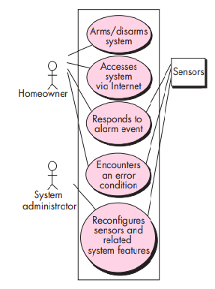

Slide 58
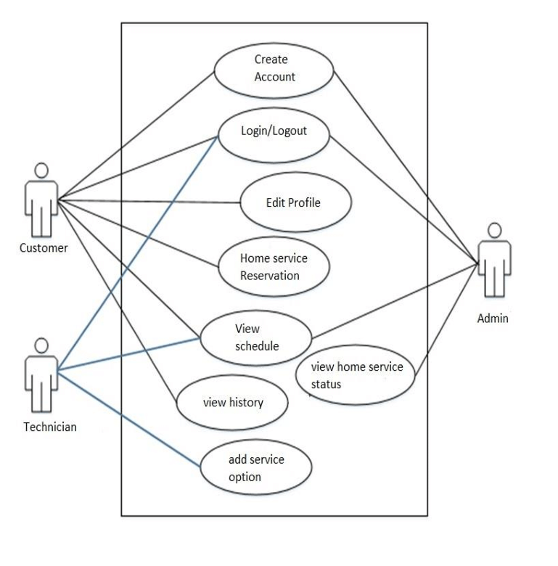
Sample Use case Diagram

Slide 59
4.Building the Analysis model
The intent of the analysis model is to provide a description of the required informational, functional, and behavioral domains for a computer-based system.
1.Elements of the Requirements Model
Different modes of representation force you to consider requirements from different viewpoints—an approach that has a higher probability of uncovering omissions, inconsistencies, and ambiguity

Slide 60
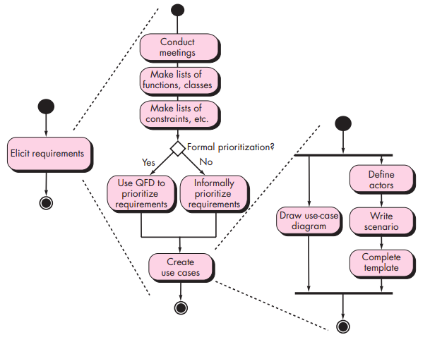

Scenario-based elements

Slide 61
Class-based elements
The system is described from the user’s point of view using a scenario-based approach
Scenario-based elements of the requirements model are often the first part of the model that is developed.
Each usage scenario implies a set of objects that are manipulated as an actor interacts with the system. These objects are categorized into classes—a collection of things that have similar attributes and common behaviors.

Slide 62
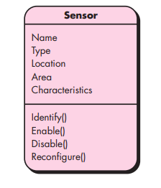

It is always a good idea to get stakeholders involved.
One of the best ways to do this is to have each stakeholder write use cases that describe how the software will be used

Slide 63
Behavioral elements
The behavior of a computer-based system can have a profound effect on the design that is chosen and the implementation approach that is applied.
The state diagram is one method for representing the behavior of a system by depicting its states and the events that cause the system to change state.
A state is any externally observable mode of behavior. In addition, the state diagram indicates actions (e.g., process activation) taken as a consequence of a particular event.

Slide 64
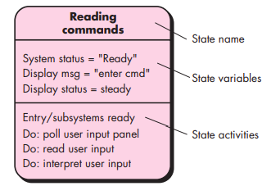


Slide 65
Flow-oriented elements
Information is transformed as it flows through a computer-based system. The system accepts input in a variety of forms, applies functions to transform it, and produces output in a variety of forms.
Input may be a control signal transmitted by a transducer, a series of numbers typed by a human operator, packet of information transmitted on a network link, or a voluminous data file retrieved from secondary storage.
The transform(s) may comprise a single logical comparison, a complex numerical algorithm, or a rule-inference approach of an expert system. Output may light a single LED or produce a 200-page report

Slide 66
2.Analysis Patterns
First, analysis patterns speed up the development of abstract analysis models that capture the main requirements of the concrete problem by providing reusable analysis models with examples as well as a description of advantages and limitations.
Second, analysis patterns facilitate the transformation of the analysis model into a design model by suggesting design patterns and reliable solutions for common problems.
suggest solutions (e.g., a class, a function, a behavior) within the application domain that can be reused when modeling many applications

Slide 67
5.Negotiating Requirements
A compromise is the art of dividing a cake in such a way that everyone believes he has the biggest piece.
The intent of this negotiation is to develop a project plan that meets stakeholder needs while at the same time reflecting the real-world constraints (e.g., time, people, budget) that have been placed on the software team.

Slide 68
The Art of Negotiation
Learning how to negotiate effectively can serve you well throughout your personal and technical life.
1.Recognize that it’s not a competition. To be successful, both parties have to feel they’ve won or achieved something. Both will have to compromise.
2. Map out a strategy. Decide what you’d like to achieve; what the other party wants to achieve, and how you’ll go about making both happen.
3. Listen actively. Don’t work on formulating your response while the other party is talking. Listen to her. It’s likely you’ll gain knowledge that will help you to better negotiate your position.

Slide 69
4. Focus on the other party’s interests. Don’t take hard positions if you want to avoid conflict.
5. Don’t let it get personal. Focus on the problem that needs to be solved.
6. Be creative. Don’t be afraid to think out of the box if you’re at an impasse.
7. Be ready to commit. Once an agreement has been reached, don’t waffle; commit to it and move on.

Slide 70
6.Validating Requirements
As each element of the requirements model is created, it is examined for inconsistency, omissions, and ambiguity.
• Is each requirement consistent with the overall objectives for the system/product?
• Have all requirements been specified at the proper level of abstraction? That is, do some requirements provide a level of technical detail that is inappropriate at this stage?
• Is the requirement really necessary or does it represent an add-on feature that may not be essential to the objective of the system?
• Is each requirement bounded and unambiguous?

Slide 71
• Does each requirement have attribution? That is, is a source (generally, a specific individual) noted for each requirement?
• Do any requirements conflict with other requirements?
• Is each requirement achievable in the technical environment that will house the system or product?
• Is each requirement testable, once implemented?
• Does the requirements model properly reflect the information, function, and behavior of the system to be built?

Slide 72
DESIGN CONCEPTS
The design process
Design Concepts
The design model

Slide 73
Introduction
Mitch Kapor, the creator of Lotus 1-2-3, presented a “software design manifesto” in Dr. Dobbs Journal. He said: Good software design should exhibit:
Firmness: A program should not have any bugs that inhibit its function.
Commodity: A program should be suitable for the purposes for which it
was intended.
Delight: The experience of using the program should be pleasurable one

Slide 74
DESIGN WITH THE CONTEXT OF SE
“The most common miracle of software engineering is the transition from analysis to design and design to code.”
Software design sits at the technical kernel of software engineering and is applied regardless of the software process model that is used.
Beginning once software requirements have been analyzed and modeled, software design is the last software engineering action within the modeling activity and sets the stage for construction(code generation and testing).

Slide 75
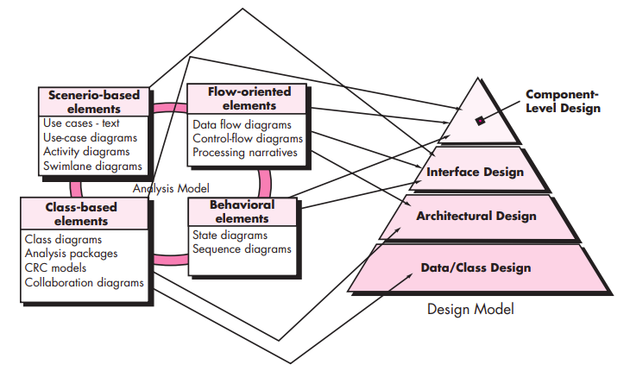
Translating the requirements model into the design model

Slide 76
The data/class design transforms class models into design class realizations and the requisite data structures required to implement the software.
The architectural design defines the relationship between major structural elements of the software, the architectural styles and design patterns that can be used to achieve the requirements defined for the system, and the constraints that affect the way in which architecture can be implemented.

Slide 77
The interface design describes how the software communicates with systems that interoperate with it, and with humans who use it. An interface implies a flow of information (e.g., data and/or control) and a specific type of behavior.
The component-level design transforms structural elements of the software architecture into a procedural description of software components.

Slide 78
DESIGN PROCESS
Software design is an iterative process through which requirements are translated into a “blueprint” for constructing the software.
The blueprint depicts a holistic view of software.

Slide 79
1.Software Quality Guidelines and Attributes
The design must implement all of the explicit requirements contained in the requirements model, and it must accommodate all of the implicit requirements desired by stakeholders.
The design must be a readable, understandable guide for those who generate code and for those who test and subsequently support the software.
The design should provide a complete picture of the software, addressing the data, functional, and behavioral domains from an implementation perspective.

Slide 80
Software Quality Guidelines
A design should exhibit an architecture that
(1)has been created using recognizable architectural styles or patterns,
(2)is composed of components that exhibit good design characteristics and
(3) can be implemented in an evolutionary fashion
For smaller systems, design can sometimes be developed linearly.
A design should be modular; that is, the software should be logically partitioned into elements or subsystems
A design should contain distinct representations of data, architecture, interfaces, and components.

Slide 81
A design should lead to data structures that are appropriate for the classes to be implemented and are drawn from recognizable data patterns.
A design should lead to components that exhibit independent functional characteristics.
A design should lead to interfaces that reduce the complexity of connections between components and with the external environment.
A design should be derived using a repeatable method that is driven by information obtained during software requirements analysis.
A design should be represented using a notation that effectively communicates its meaning.

Slide 82
Software Quality Attributes
Functionality- assessed by evaluating the feature set and capabilities of the program.
Usability- assessed by considering human factors overall aesthetics, consistency, and documentation.
Reliability- evaluated by measuring the frequency and severity of failure.
Performance- measured by considering processing speed, response time, resource consumption, throughput, and efficiency.
Supportablity- combines the ability to extend the program (extensibility), adaptability, serviceability

Slide 83
2.The Evolution of Software Design
Procedural aspects of design definition evolved into a philosophy called structured programming .
Newer design approaches proposed an object-oriented approach to design derivation.
Growing emphasis on aspect-oriented methods model-driven development and test-driven development emphasize techniques for achieving more effective modularity and architectural structure in the designs that are created.

Slide 84
All of these methods have a number of common characteristics:
a mechanism for the translation of the requirements model into a design representation,
(2) a notation for representing functional components and their interfaces,
(3) heuristics for refinement and partitioning, and
(4) guidelines for quality assessment

Slide 85
2.Design Concepts
A set of fundamental software design concepts has evolved over the history of software engineering.
Each provides the software designer with a foundation from which more sophisticated design methods can be applied. Each helps you answer the following questions:
What criteria can be used to partition software into individual components?
How is function or data structure detail separated from a conceptual representation of the software?
What uniform criteria define the technical quality of a software design?

Slide 86
M. A. Jackson [Jac75] once said: “The beginning of wisdom for a [software engineer] is to recognize the difference between getting a program to work, and getting it right.”
Fundamental software design concepts provide the necessary framework for “getting it right.”

Slide 87
Abstraction—data, procedure, control
Architecture—the overall structure of the software
Patterns—”conveys the essence” of a proven design solution
Separation of concerns—any complex problem can be more easily
handled if it is subdivided into pieces
Modularity—compartmentalization of data and function
Hiding—controlled interfaces
7

Slide 88
Functional independence—single-minded function and low coupling
Refinement—elaboration of detail for all abstractions
Aspects—a mechanism for understanding how global requirements
affect design
Refactoring—a reorganization technique that simplifies the design
OO design concepts—OO design concepts such as classes and objects, inheritance, messages, and polymor phism, among others.
Design Classes—provide design detail that will enable analysis
classes to be implemented
7

Slide 89












1.A data abstraction is a named collection of data that describes a data object.

Slide 90


A procedural abstraction refers to a sequence of instructions that have a specific and limited function.
details of enter algorithm
implemented with a "knowledge" of the object that is associated with enter
.

Slide 91


2.Architecture
“The overall structure of the software and the ways in which that structure provides conceptual integrity for a system.”
Structural properties. This aspect of the architectural design representation defines the components of a system (e.g., modules, objects, filters) and the manner in which those components are packaged and interact with one another.
Extra-functional properties. The architectural design description should address how the design architecture achieves requirements for performance, capacity, reliability, security, adaptability, and other system characteristics.
Families of related systems. The architectural design should draw upon repeatable patterns that are commonly encountered in the design of families of similar systems. In essence, the design should have the
ability to reuse architectural building blocks.
10

Slide 92
3.Patterns
Design Pattern Template
Pattern name—describes the essence of the pattern in a short but expressive name
Intent—describes the pattern and what it does
Also-known-as—lists any synonyms for the pattern
Motivation—provides an example of the problem
Applicability—notes specific design situations in which the pattern is applicable
Structure—describes the classes that are required to implement the pattern
Participants—describes the responsibilities of the classes that are
required to implement the pattern
Collaborations—describes how the participants collaborate to carry out their responsibilities
Consequences—describes the “design forces” that affect the pattern and the potential trade-offs that must be considered when the pattern is implemented
Related patterns—cross-references related design patterns
11

Slide 93
Design pattern describes a design structure that solves a particular design problem within a specific context and amid “forces” that may have an impact on the manner in which the pattern is applied and used.
The intent of each design pattern is to provide a description that enables a designer to determine
(1) whether the pattern is applicable to the current work,
(2) whether the pattern can be reused (hence, saving design time), and
(3) whether the pattern can serve as a guide for developing a similar, but functionally or structurally different pattern

Slide 94
4.Separation of Concerns
Any complex problem can be more easily handled if it is subdivided into pieces that can each be solved and/or optimized independently
A concern is a feature or behavior that is specified as part of the requirements model for the software
By separating concerns into smaller, and therefore more manageable pieces, a problem takes less effort and time to solve.

Slide 95
5.Modularity
"modularity is the single attribute of software that allows a program to be intellectually manageable" .
Monolithic software (i.e., a large program composed of a single module) cannot be easily grasped by a software engineer.
The number of control paths, span of reference, number of variables, and overall complexity would make understanding close to impossible.
In almost all instances, you should break the design into many modules, hoping to make understanding easier and as a consequence, reduce the cost required to build the software.

Slide 96
Cost of effort
Total software cost
Cost to integrate
Region of minimum cost
M
Number of modules

Slide 97



6.Information Hiding
Hiding implies that effective modularity can be achieved by defining a set of independent modules that communicate with one another only that information necessary to achieve software function.
The use of information hiding as a design criterion for modular systems provides the greatest benefits when modifications are required during testing and later during software maintenance

Slide 98
7.Functional Independence
Functional independence is achieved by developing modules with "single-minded" function and an "aversion" to excessive interaction with other modules.
Cohesion is an indication of the relative functional strength of a module.A cohesive module performs a single task, requiring little interaction with other components in other parts of a program. Stated simply, a cohesive module should (ideally) do just one thing.
Coupling is an indication of the relative interdependence among modules.Coupling depends on the interface complexity between modules, the point at which entry or reference is made to a module, and what data pass across the interface.

Slide 99
8.Refinement
Refinement is actually a process of elaboration.
Abstraction and refinement are complementary concepts. Abstraction enables you to specify procedure and data internally but suppress the need for “outsiders” to have knowledge of low-level details.
Refinement helps you to reveal low-level details as design progresses.

Slide 100



Stepwise Refinement
open
walk to door; reach for knob;
open door;
repeat until door opens
walk through;
if knob doesn't turn, then
find correct key; insert in lock;
endif
pull/push door move out of way; end repeat

Slide 101
9.Aspects
Consider two requirements, A and B. Requirement A crosscuts requirement B “if a software decomposition [refinement] has been chosen in which B cannot be satisfied without taking A into account.
An aspect is a representation of a cross-cutting concern.
Cross-cutting concerns are parts of a program that rely on or must affect many other parts of the system. They form the basis for the development of aspects. Such cross-cutting concerns do not fit cleanly into object-oriented programming or procedural programming.

Slide 102
10.Refactoring
Fowler [FOW99] defines refactoring in the following manner:
"Refactoring is the process of changing a software system in such
a way that it does not alter the external behavior of the code
[design] yet improves its internal structure.”
When software is refactored, the existing design is examined for
Redundancy
unused design elements
inefficient or unnecessary algorithms
poorly constructed or inappropriate data structures
or any other design failure that can be corrected to yield a better design.

Slide 103
11.OO Design Concepts
Inheritance—all responsibilities of a superclass is immediately inherited by all subclasses
Messages—stimulate some behavior to occur in the receiving object
Polymorphism—a characteristic that greatly reduces the effort required to extend the design

Slide 104
12.Design Classes
Five different types of design classes, each representing a different layer of the design architecture.
User interface classes define all abstractions that are necessary for humancomputer interaction (HCI).
Business domain classes are often refinements of the analysis
Process classes implement lower-level business abstractions
Persistent classes represent data stores (e.g., a database) that will persist beyond the execution of the software.
System classes implement software management and control functions that enable the system to operate and communicate within its computing environment and with the outside

Slide 105
3.Design Model
The process dimension indicates the evolution of the design model as design tasks are executed as part of the software process.
The abstraction dimension represents the level of detail as each element of the analysis model is transformed into a design equivalent and then refined iteratively.

Slide 106
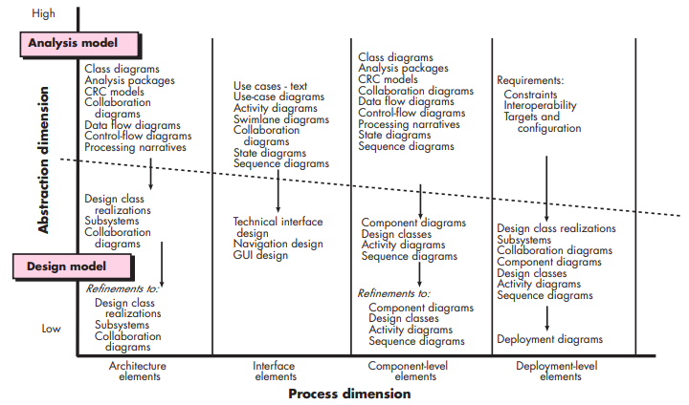

Slide 107
1.Data Design Element
Data design (sometimes referred to as data architecting) creates a model of data and/or information that is represented at a high level of abstraction (the customer/user’s view of data).
This data model is then refined into progressively more implementation-specific representations that can be processed by the computer-based system.
At the program component level, the design of data structures and the associated algorithms required to manipulate them is essential to the creation of high-quality applications.
At the application level, the translation of a data model (derived as part of requirements engineering) into a database is pivotal to achieving the business objectives of a system.
At the business level, the collection of information stored in disparate databases and reorganized into a “data warehouse” enables data mining or knowledge discovery that can have an impact on the success of the business itself.

Slide 108
2.Architectural Elements
The Architectural design elements give us an overall view of the software,architectural model is derived from three sources:
information about the application domain for the software to be built;
specific requirements model elements such as data flow diagrams or analysis classes, their relationships and collaborations for the problem at hand, and
the availability of architectural patterns and styles

Slide 109
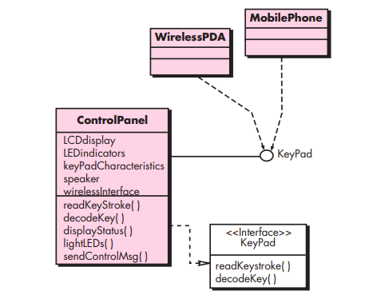
3.Interface Design Elements

Slide 110
The interface design elements for software depict information flows into and out of the system and how it is communicated among the components defined as part of the architecture. There are three important elements of interface design:
(1) the user interface (UI);
(2) external interfaces to other systems, devices, networks, or other producers or consumers of information; and
(3) internal interfaces between various design components.

Slide 111
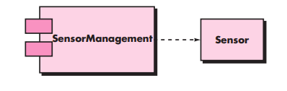
4.Component-Level Design Elements

Slide 112
The component-level design for software fully describes the internal detail of each software component.
To accomplish this, the component-level design defines data structures for all local data objects and algorithmic detail for all processing that occurs within a component and an interface that allows access to all component operations (behaviors)

Slide 113
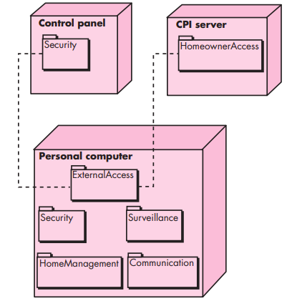
5.Deployment-Level Design Element

Slide 114
Deployment-level design elements indicate how software functionality and subsystems will be allocated within the physical computing environment that will support the software.

Slide 115
Thank you
.

